Slide 1
SCHOOLS2030'S APPROACH TO ASSESSMENT:
Re-balancing power dynamics and reconceptualising ‘rigour’
in measuring learning

Slide 2
SESSION AGENDA
Part 1: Introduction to Schools2030 Programme Dr Bronwen Magrath, Schools2030 Global Programme Manager, Aga Khan Foundation
Part 2: Rethinking Rigour in Schools2030 Assessment Dr Rachel Outhred, Managing Director, Oxford MeasurEd
Part 3: Power Dynamics in Assessments: What matters to Who – Reflections from India Arjun Sanyal, Senior Programme Officer, Aga Khan Foundation
Break: Reflection Exercise: How do we view assessments?
Fergal Turner, Senior Consultant, Oxford MeasurEd
Part 4: Defining What Gets measured – Perspectives from Uganda Emily Tusiime, Regional Assessment Lead in East Africa, Aga Khan Foundation Brenda Naggayi, Home School Teacher
Part 5: Discussion and reflections
Prof. Caine Rolleston, University College London

Slide 3
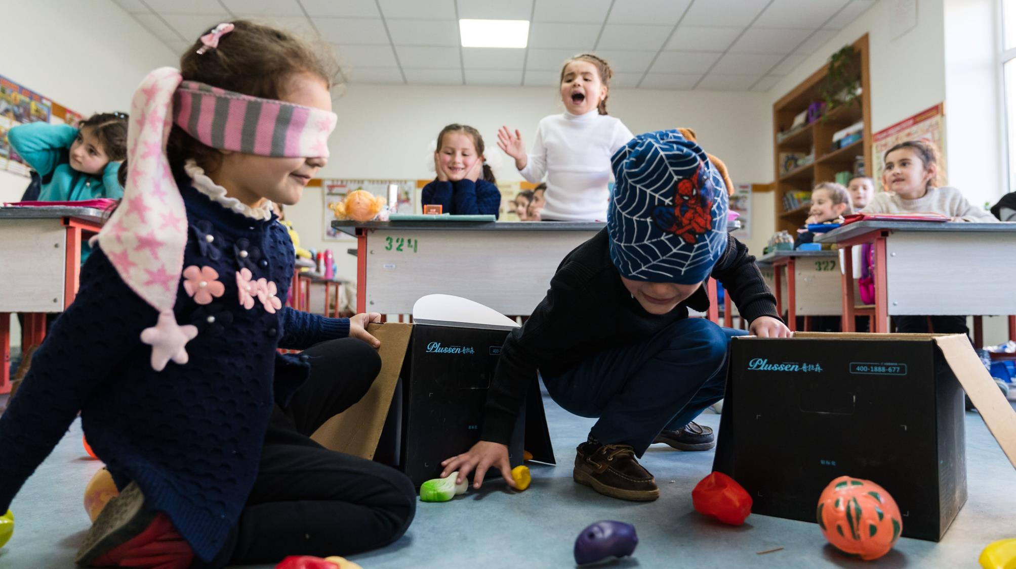
INTRODUCING
SCHOOLS2030

Slide 4
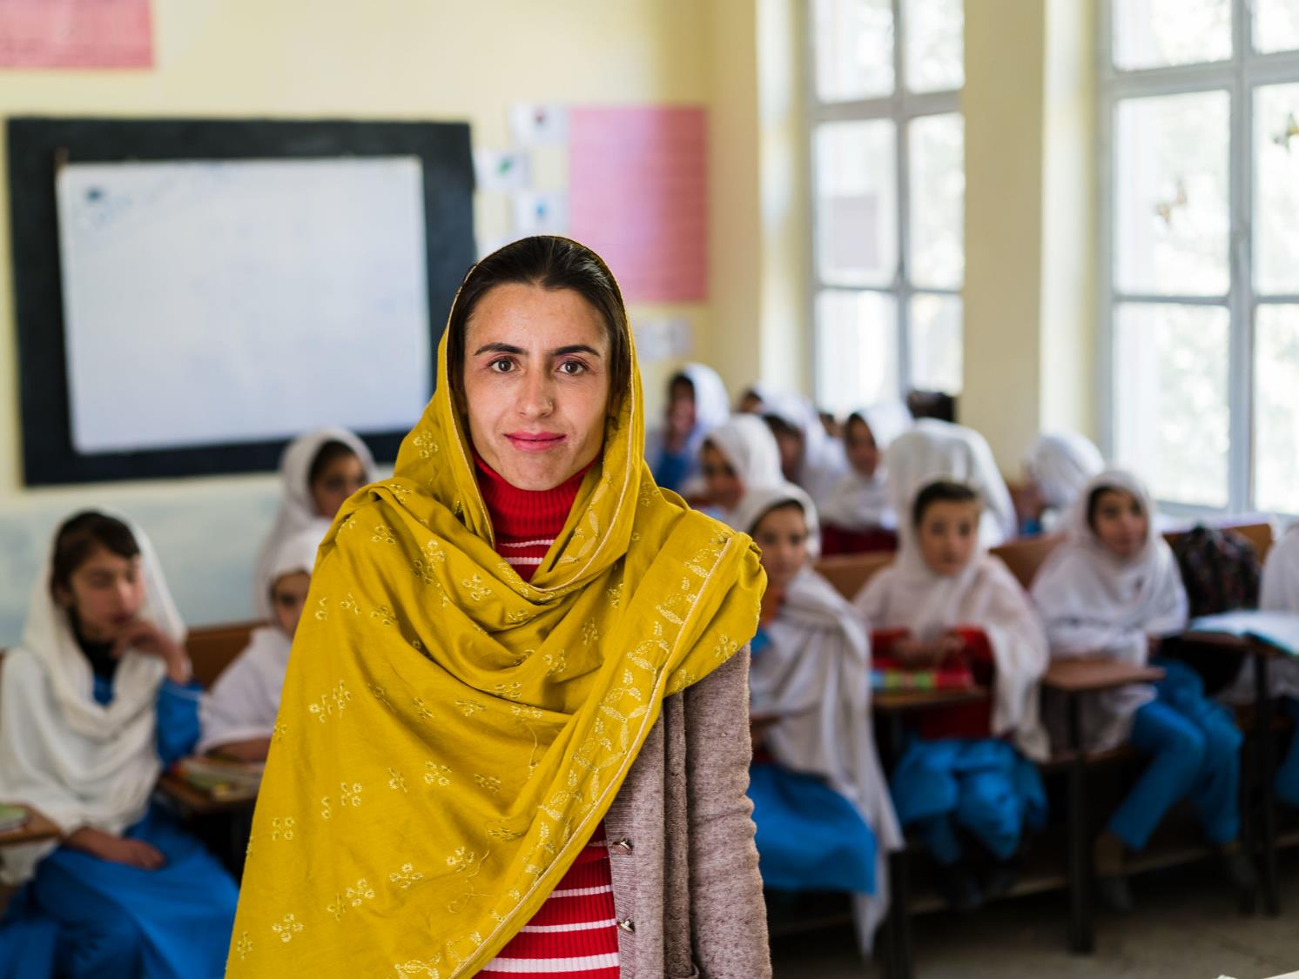
Schools2030 catalyses locally-rooted, teacher-driven education innovations to improve holistic learning outcomes for the most marginalised learners.

Slide 5
WHERE WE WORK
Schools2030 works in 1000 government schools and with National Advisory Committees across 10 countries

Slide 6

Through human-centered design, teachers and students develop and implement education “micro-innovations” to address the holistic learning needs of their classrooms and communities.

Slide 7
Micro-innovations are designed to be low-cost, replicable, and shareable – informing systems-level educational change and showcasing the role of schools in the achievement of SDG4

Slide 8
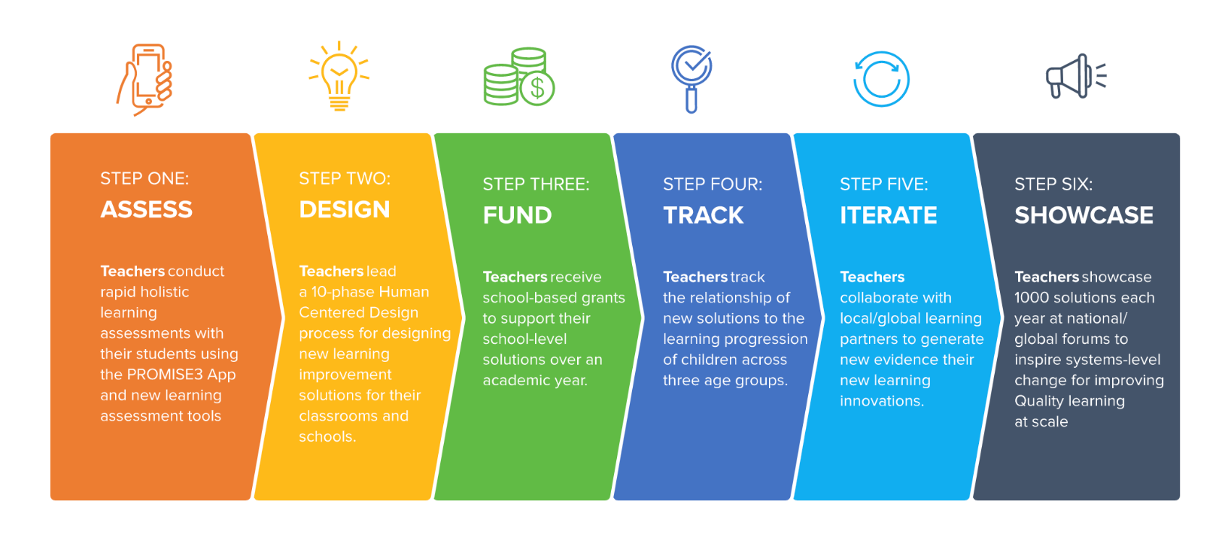
OUR SIX STEP MODEL

Slide 9
OUR APPROACH TO ASSESSMENT Three Underpinning Values:

Slide 10
OUR APPROACH TO ASSESSMENT Three Underpinning Values:
Assessment tools must be useful and useable by teachers as part of their human-centred design journeys

Slide 11
OUR APPROACH TO ASSESSMENT Three Underpinning Values:
Assessment tools must be useful and useable by teachers as part of their human-centred design journeys
Assessment tools must be contextually-relevant

Slide 12
OUR APPROACH TO ASSESSMENT Three Underpinning Values:
Assessment tools must be useful and useable by teachers as part of their human-centred design journeys
Assessment tools must be contextually-relevant
Assessment tools must be free and open source

Slide 13

In consultation with National Advisory Committees, each country has identified five key domains to focus on for each age group

Slide 14
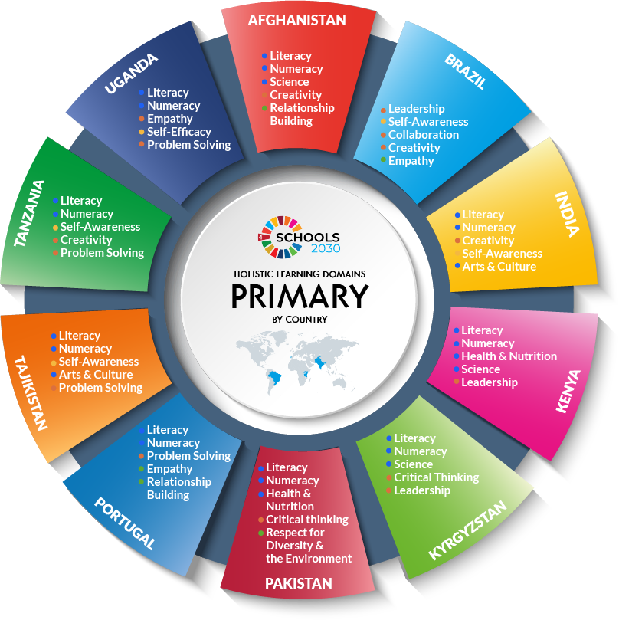
In consultation with National Advisory Committees, each country has identified five key domains to focus on for each age group

Slide 15
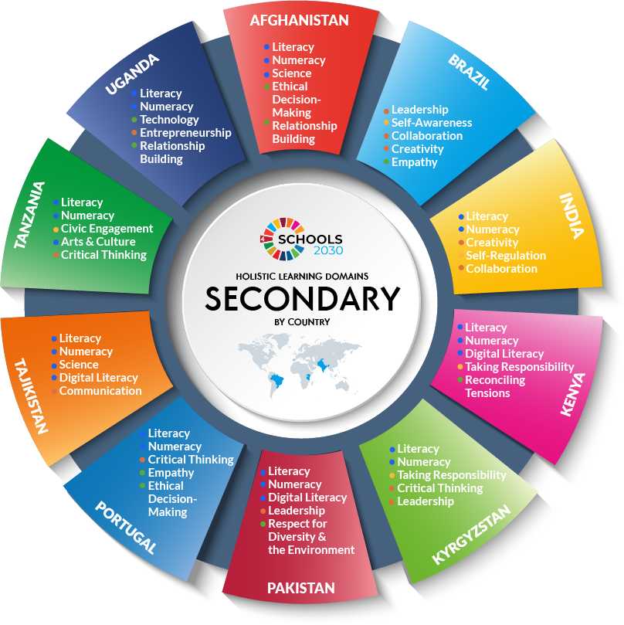
In consultation with National Advisory Committees, each country has identified five key domains to focus on for each age group

Slide 16







India
Showcase
Pakistan
Brazil
Iterate
Track
Fund
Design
Portugal
Tanzania
Afghanistan
Assess
Kenya
Tajikistan
Uganda
Kyrgyzstan

Slide 17
1.
Assessments provide data to support teachers in designing classroom based solutions
Bronwen Magrath
Introduction to Assessment in Schools2030 (10 mins)
3.
10 National Assessment partners facilitate conversations to set priorities, and develop assessment tools for teachers to use
Arjun Sanyal
The politics of what gets measured in India (15 mins)
India
Showcase
Pakistan
Brazil
Iterate
Track
Fund
Design
Portugal
Tanzania
Afghanistan
Assess
Kenya
Tajikistan
Uganda
Kyrgyzstan
2.
Global Partners develop strategy and guidance materials, provide support, and synthesise evidence from assessments.
Rachel Outhred
The Schools2030 approach to assessment (15 mins)
4.
Teachers and schools support in defining priorities for measurement, and deliver and use the results of assessments
Emily Tusiime and Brenda Naggayi
Schools2030 Holistic Learning Domains in Uganda (20 mins)

Slide 18
Thank you
Dr. Bronwen Magrath
Schools2030 Global Programme Manager
Aga Khan Foundation
bronwen.magrath@akdn.org

Slide 19
RETHINKING RIGOUR IN SCHOOLS2030 ASSESSMENT

Slide 20






1) What do we mean by rigour?
2) Rigour in learning assessments
3) The role of rigour in experimental innovation
4) Top down and bottom-up solutions – using iteration
5) Doing all of this with an eye on those who have the most “skin in the game”

Slide 21
1) WHAT DO WE MEAN BY “RIGOUR”?
Notes:
We use the word “rigour” all the time in our work.
“rigour is at the heart of our work”, “yes he or she is very rigorous”, “don’t lose sight of rigour”
Rigour is good and important. But what do we really mean by rigour?

Slide 22
Academic Rigour
“the fact of being careful and paying great attention to detail”

Slide 23
Severity
“This crime must be treated with the full rigour
of the law”

Slide 24
Difficulties and unpleasant conditions
“The plants were unable to withstand the rigours
of a harsh winter”

Slide 25
2) RIGOUR IN ASSESSMENTS AND LEARNING
Validity, Reliability and Fairness
“Validity is an integrated evaluative judgement of the degree to which empirical evidence and theoretical rationales support the adequacy and appropriateness of inferences and actions based on test scores or other modes of assessment”
(Messick 1989 p 13)
Notes:
Messick emphasised these words (not me) adequacy, appropriateness, inferences and ACTION.
Of course, Crooks, Kane and Cohen’s seminal “Threats to Validity” takes us through many of the stages in the assessment process in which we need to pay great attention to details – but often approaches to developing assessments of learning become so focused on these details - in the name of “rigour” – that the bigger picture is missed.
Overall, assessment of learning need to result in adequate and appropriate inference towards action.

Slide 26
…towards action
Information users need to be at the heart
of the process.

Slide 27
Adequate and appropriate
The Schools2030 approach to assessment recognises that high-quality measurement instruments are context driven.
Notes:
The Schools2030 approach to assessment recognises that high-quality measurement instruments are context driven.
We know that Instrumentation is by nature narrow, reducing phenomena down to simpler, quantifiable constructs. This allows for the measurement of human attributes for comparative purposes,
but the constructs remain samples of behaviour representing complex, unobservable traits.
Particularly as we are assessing holistic learning outcomes, the kinds of behaviours that are representative of the construct are fundamentally contextual and cultural and sit within complex social ecologies of children’s lives.
This includes behaviours in relation to their peers and within their families and communities. Instrumentation (cognitive and holistic learning outcomes) that does not reflect the experiences of children in the locale will be unlikely to capture the intended attribute in a meaningful manner.
For this reason, we see measurement precision as fundamentally linked to context and therefore, item and tool development (or adaptation) must be context driven.
We often talk about the need for instruments to be contextually adapted from the global, to the local. However too often approaches in the sector are either bottom-up or top-down. The result is either assessments that do not adequately capture context (which is a threat to validity), or assessments that do not meet minimum more technical validity and reliability thresholds.
In Schools2030, we resolve this tension through the use of iteration.

Slide 28


A context-driven iterative approach – to achieve rigour and reduce risk
The importance of rigour
“…in a recent systematic review of the assessment of language and literacy skills for children in developing countries between 1990 and 2014, Sonali Nag and her team of researchers found that the reporting of reliability and validity for assessments in developing countries is very rare. Over 70 percent of the studies rated as having ‘Moderate’ and ‘High’ methodological rigour did not even report on test reliability. Moreover, studies that did report reliability included levels as low as 0.23 on Cronbach’s alpha – a common measure of internal test reliability that ranges between 0 and 1, with anything below 0.5 considered as unacceptable. Finally, few of the studies reviewed used methodologies that can ensure tests are capturing a child’s true performance…” (Outhred, 2017)

Slide 29
3) THE ROLE OF RIGOUR IN EXPERIMENTAL INNOVATION

Slide 30


EXPERIMENTAL INNOVATION

Slide 31
4) TOP-DOWN AND BOTTOM-UP SOLUTIONS

Slide 32

The Schools2030 assessment approach balances risk and rigour by employing a country driven, top-down/bottom-up approach. This means:
National stakeholders (including national assessment partners) define constructs and choose measures
Global Assessment Partners support national teams through iteration – providing guidance and feedback
Contextual relevance is conceptualized as an essential component of quality assessments
Driven by those closest to users
Contextually Relevant
Local Buy-in
Able to drive up reliability and validity
Risks: a lack of relevance for policy or practice, not matching teachers’ realities, not capturing the realties of children’s lives
Risks: reliability/validity
Bottom Up
Top Down

Slide 34
5) POSITIONING THOSE WHO HAVE THE MOST “SKIN IN THE GAME”

Slide 35

CHILDREN AND YOUNG LEARNERS – stakeholders with “skin in the game”
If the Schools2030 programme and other international programmes do not improve learning, children and young people in these contexts have the most to lose.
This means being constantly cognizant that this is not a technical exercise for its own sake.
The approach positions children and young people as individuals with agency, knowledge, skills
and experiences, worthy of human dignity and respect.
Notes:
And finally…
Our approach recognises that the children and young people participating in the programme have the most to lose if the programme fails.
We recognise that this is not a technical exercise for its own sake.

Slide 36
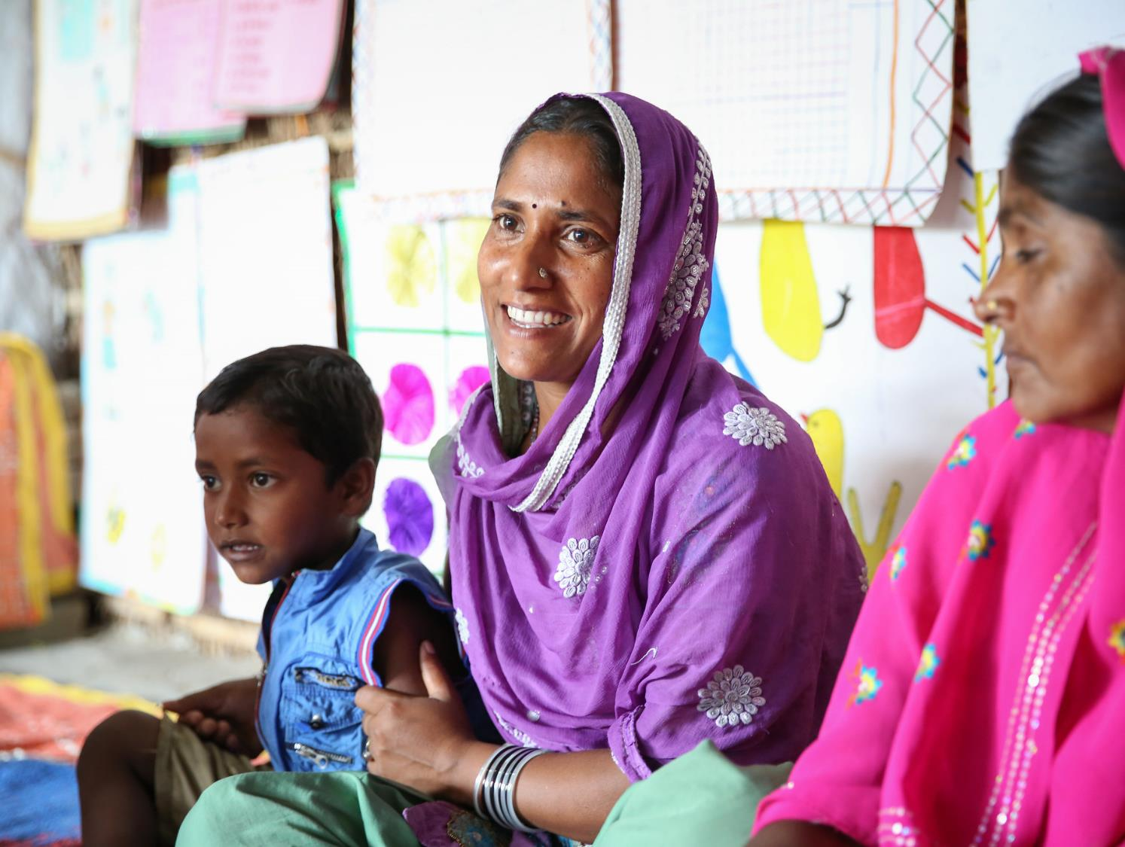
In practical terms, this means:
ensuring decisions are informed by the need to improve the learning and life chances of these children and young people as end goal;
actively seeking out information on children’s experiences participating in the assessment (through partners) and adjusting protocols when needed;

Slide 37

ensuring the tools and delivery methods respect and reflect the experiences of young people and provide them with opportunities to demonstrate what they know in non-traditional ways; and
articulating learning in terms of what children know and what they need to learn next, rather than deficit descriptions of what they do not know and cannot do

Slide 38
Thank you
Rachel Outhred
Managing Director
Oxford MeasurEd
Schools2030 Global Learning Assessment Coordinating Partner
rachel.outhred@oxfordmeasured.co.uk

Slide 39
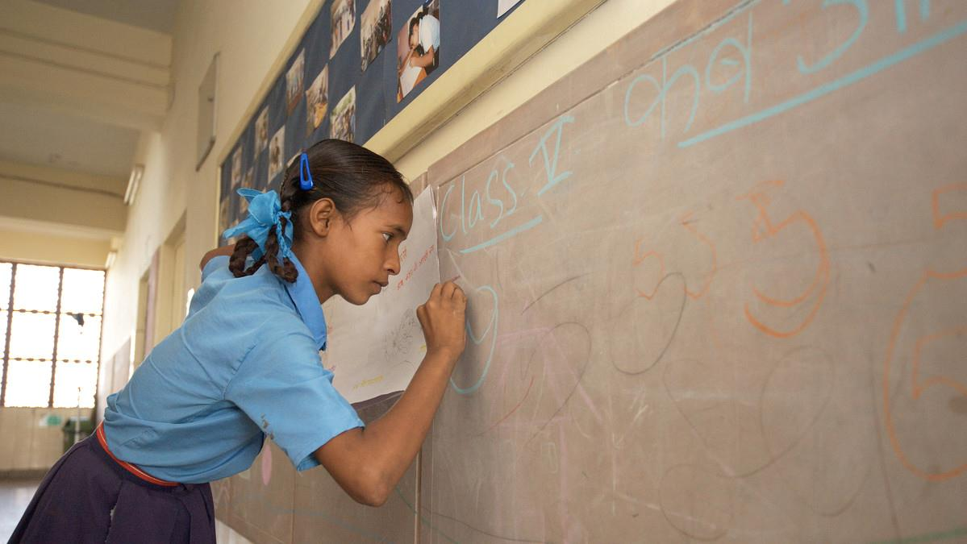

POWER DYNAMICS
IN ASSESSMENT: WHAT MATTERS TO WHO REFLECTIONS FROM INDIA

Slide 40
POWER DYNAMICS IN ASSESSMENT - what matters to who
This presentation shares reflections about different stakeholder perspectives regarding education assessments, and how they differ, or are the same, based on their role and relative influence in the education ecosystem, and reflections from the AKF India team about the selection of learning outcome domains in Schools2030.

Slide 41
STAKEHOLDERS AND THEIR ROLES
What needs to be measured and how is decided mostly by Government authorities, with children having the least voice in the process
Ministry of Education
Department of Education, State Govt.
National Council for Education Research and Training (NCERT)
Assessment agencies / experts
State Council for Education Research and Training (SCERT)
Teacher educators
Boards of Assessment (e.g. Central Board of Secondary Education)
Teachers
Private sector (tutors, coaching classes, online education providers)
State Boards (e.g. Bihar School Examination Board)
Parents and caregivers
National Assessment Centre*
Children

Slide 42
WHAT MATTERS TO POLICY-MAKERS
National Education Policy (NEP) 2020 -
The primary purpose of assessment will indeed be for learning; it will help the teacher and student, and the entire schooling system, continuously revise teaching-learning processes to optimize learning and development for all students. This will be the underlying principle for assessment at all levels of education.
shift from summative and primarily tests rote memorization skills to one that is more regular and formative, is more competency-based, …tests higher-order skills, such as analysis, critical thinking, and conceptual clarity (4.34)
existing system of examinations shall be reformed to eliminate the need for undertaking coaching classes (4.37)
school examinations in Grades 3, 5, and 8… along with relevant higher-order skills and application of knowledge in real-life situations… test basic literacy, numeracy, and other foundational skills. (4.40)
assessment methods must be scientific, designed to continuously improve learning and test the application of knowledge (12.1)
NIPUN Bharat Mission -
Achieve universal foundational literacy and numeracy in primary school by 2025

Slide 43

WHAT MATTERS TO TEACHERS
Curricular subjects like language and mathematics outcomes tend to be considered more important, especially since successive annual surveys shows learning gaps in foundational literacy and numeracy skills
Continuous and Comprehensive Evaluation (CCE), a system emphasizing formative assessments, did not lead to improvements in test scores, and was considered time-consuming and “yet another burdensome administrative requirement, rather than a teaching aide”
Teachers were not using assessment data to improve teaching learning process

Slide 44
WHAT MATTERS TO TEACHERS CONTINUED
So, what would teachers want from assessments?
Simplicity
Ease of administration
Ease of recording
Areas for exploration:
How might we design assessments that provide information to teachers about student’s holistic learning outcomes, but are not cumbersome or rigid?
How might we enable teachers to share insights with parents and children?

Slide 45
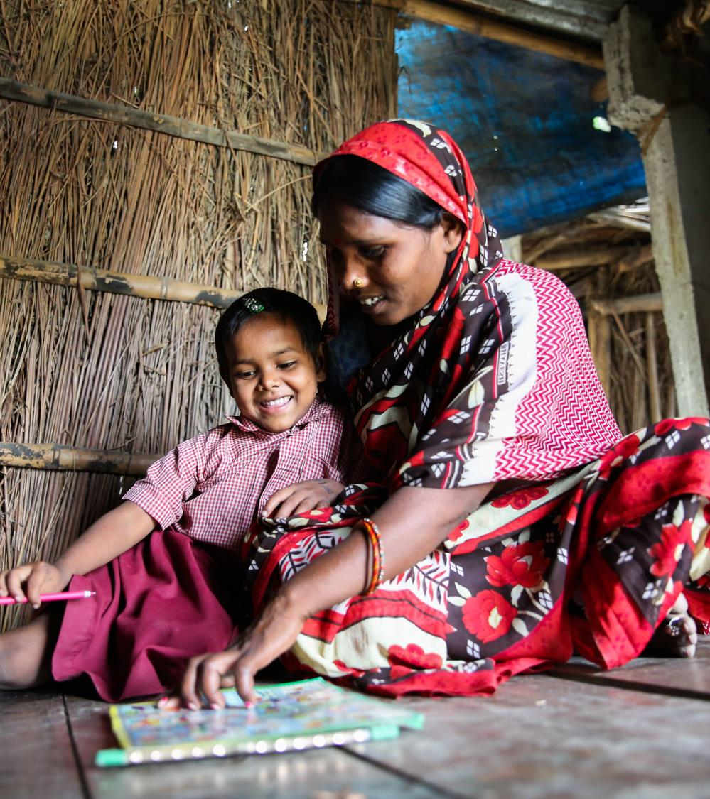
WHAT MATTERS
TO PARENTS
What matters may differ across socio-economic criteria
Purpose of education - Good citizens
Indicator of quality for parents - Exam results
Ability to get a job is considered important
Teachers and community leaders are key influencers, and shape parents’ perspectives
Learning outcome domains in demand - English language learning and computers (digital literacy)

Slide 46
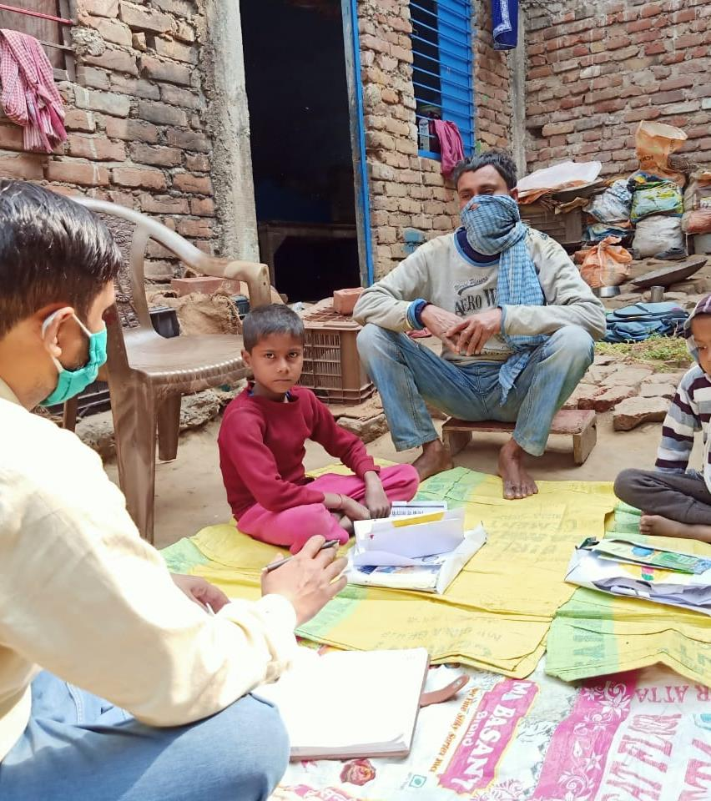
WHAT MATTERS TO PARENTS CONTINUED
Areas for exploration:
How might we simplify Learning Outcome definitions?
How might we present LOs in a manner that most parents understand?

Slide 47
REFLECTIONS FROM OUR SELECTION PROCESS
Inter-disciplinary domains need to be unpacked further. E.g. Health and Nutrition
Concepts like resilience may resonate differently across contexts and stakeholders
SEL domains require more training
Domains like creativity may have sub-domains / parameters – does measuring it well mean that we need to design a comprehensive tool for creativity? When does comprehensive become complex?
The gap between standardized assessments and contextual reality has increased due to COVID-19. Expectation from children has not changed, and parents and teachers feel helpless.

Slide 48
REFLECTIONS FROM OUR SELECTION PROCESS CONTINUED
Areas for exploration:
How might we best contextualize the definitions of Learning Outcome domains?
How might we equip teachers with simple tools and techniques for SEL domains?
How might we have scientific methods for assessment, and at the same time, keep it simple for teachers, parents and children?

Slide 49
LEARNING OUTCOME DOMAINS SELECTED IN INDIA
KNOWLEDGE
SKILLS
VALUES
ATTITUDES
ACADEMIC PROFICIENCIES
Literacy
Numeracy & mathematics
INTERDISCIPLINARY KNOWLEDGE
Science
Health & nutrition
Humanities
Arts & culture
Digital literacy, technology & media
21st CENTURY SKILLS
Communication
Collaboration
Creativity
Critical thinking
Leadership
Problem-solving
Entrepreneurship
PLURALISTIC DISPOSITIONS
Reconciling tensions
Empathy
Relationship building
Open mindedness
Respect for diversity
Resilience
ETHICAL DISPOSITIONS
Self-awareness
Self-efficacy
Self-control
Civic engagement
Ethical decision-making
Respect for the environment
Taking responsibility
The 2 + 3 model of selecting Learning Outcomes in Schools2030 considers the reality of the Indian context, where Literacy and Numeracy will be measured for each cohort
New areas like Creativity, that are most relevant to teachers, parents and children, will be included
AKF has a key role in this process to balance the power dynamics
Consultative approach towards selection
HCD process involves teachers interviewing children, and understanding what matters to them

Slide 50
References National Education Policy, 2020, Ministry of Education, Government of India Duflo E, Berry J, Mukerji S and Shotland M, 2015. A wide-angle view of learning: evaluation of the CCE and LEP programmes in Haryana, India Berry J, Kannan H, Mukerji S and Shotland M, 2018. Failure of Frequent Assessment: An Evaluation of India’s Continuous and Comprehensive Evaluation Program Winthrop R, Ershadi M, 2021. Know Your Parents - A global study of family beliefs, motivations, and sources of information on schooling, Center for Universal Education at Brookings
Thank you
Arjun Sanyal
Senior Programme Officer – Education
Aga Khan Foundation
arjun.sanyal@@akdn.org

Slide 51
DEFINING WHAT GETS MEASURED IN UGANDA

Slide 52
WHAT GETS MEASURED IN UGANDA?

Slide 53

WHO DECIDES WHAT
GETS MEASURED?

Slide 54
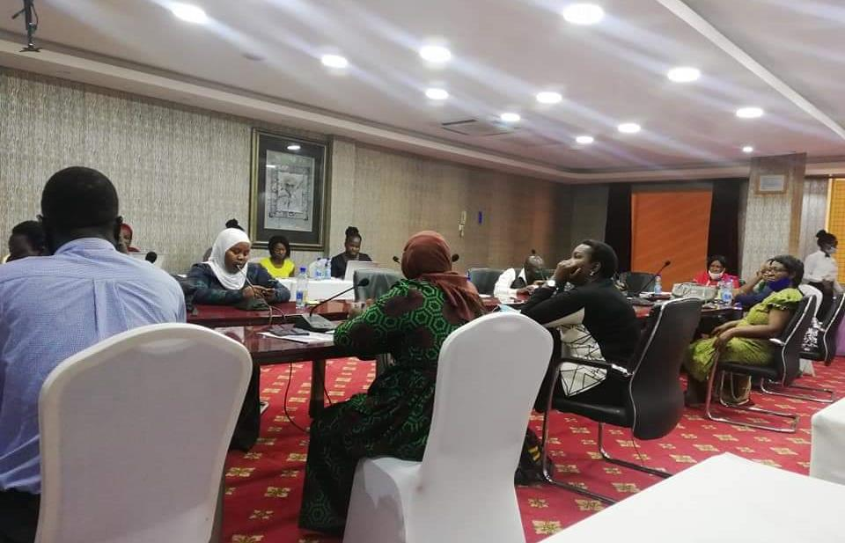
There are groups
of people who contribute to the decision of what
gets measured.

Slide 55
BUT WHICH GROUPS OF PEOPLE ARE THESE?
Ministry of Education
National Curriculum Development Centre
Reading Associations
Teachers
Youth Development Spaces
Civil Society
Out-of-School girls and boys

Slide 56
WHAT GETS MEASURED GETS IMPROVED
Robin Sharma

Slide 57
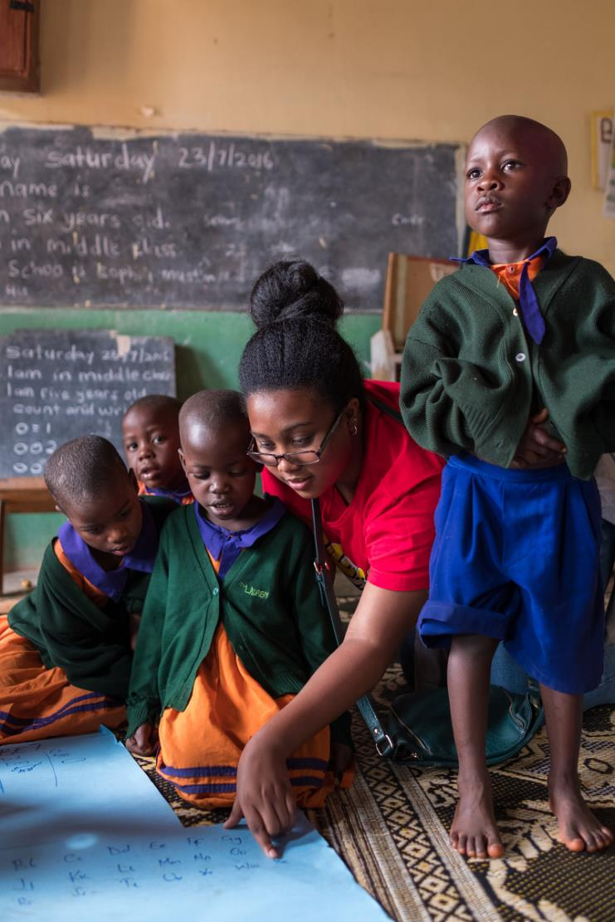
WHAT SPEAKS TO US AS A COUNTRY?
To answer this question, we looked at the National Education Goals:
NATIONAL UNITY
CULTURAL KNOWLEDGE
MORAL VALUES

Slide 58

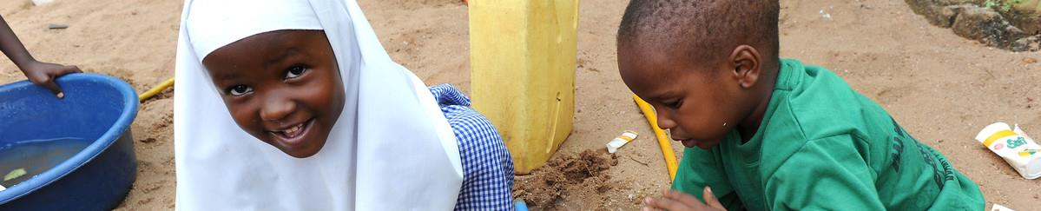
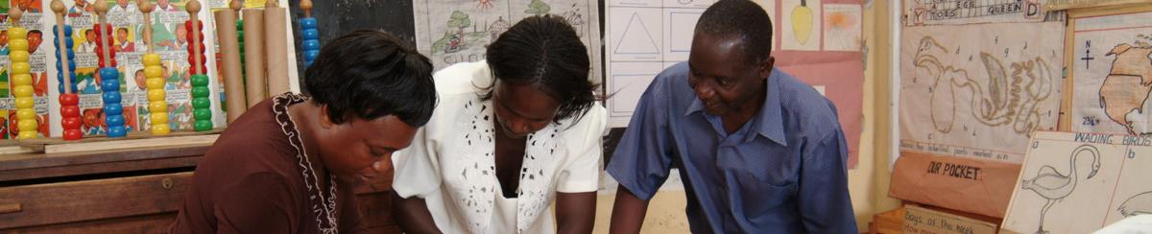

WHAT GETS MEASURED AT PRE-SCHOOL?
Using the learning framework, three non-academic
learning domains were selected:
CREATIVITY
CULTURAL ORIENTATION
RELATIONSHIP-BUILDING

Slide 59
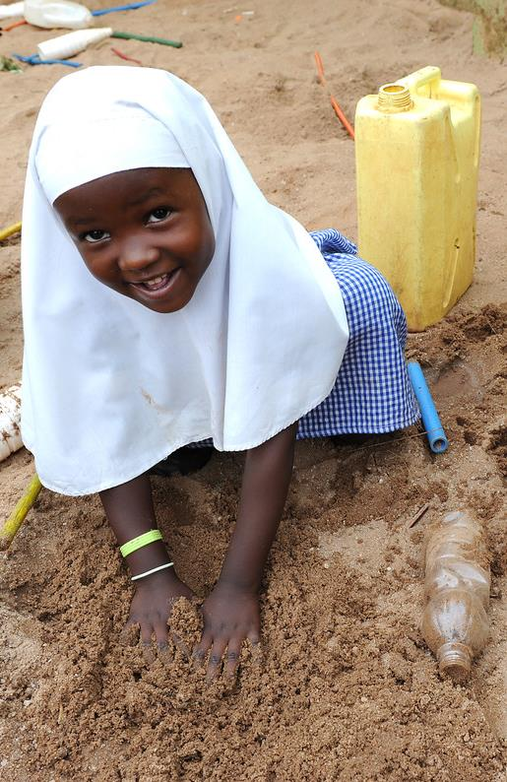
RATIONALE FOR SELECTING
CREATIVITY, CULTURAL
ORIENTATION AND
RELATIONSHIP-BUILDING
These learning domains are the vital skills for 5 year olds as a foundation for development and success later in life.

Slide 60
CREATIVITY
WHY: It is very important to allow a child to express themselves in different ways.
WHAT WILL BE MEASURED:
Flexibility
Imagination
Curiosity
Originality of ideas

Slide 61
RELATIONSHIP-BUILDING
WHY: It is through relationships that children learn how to think, communicate, express emotions and develop social skills.
WHAT WILL BE MEASURED:
Playfulness
Consideration for others
Responsiveness

Slide 62
CULTURE
WHY: Cultural orientation is an inclination to think, feel or act in a way that is culturally determined.
WHAT WILL BE MEASURED:
Ability to speak local language
Functionality
Ability to embrace diversity

Slide 63
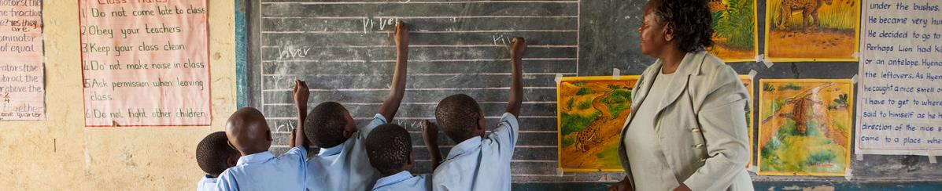
WHAT GETS MEASURED AT PRIMARY FOUR?
SELF EFFICACY
EMPATHY
PROBLEM SOLVING

Slide 64
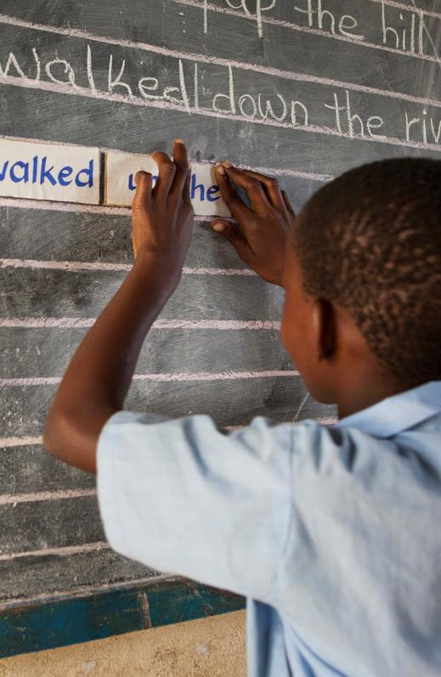
RATIONALE FOR SELECTING
SELF EFFICACY, EMPATHY
AND PROBLEM SOLVING
These skills address the main challenges a 10 year old faces in school.
They also correlate with the developmental milestones of this particular age group.

Slide 65
SELF EFFICACY
WHY: How well or poorly a person is able to cope with a given situation based on the skills they have and circumstances they face is vital.
WHAT WILL BE MEASURED:
Responding to criticism
Approach to Difficult Tasks
Finding Solutions to Complex Issues

Slide 66
EMPATHY
WHY: Ability to understand and share feelings of others.
WHAT WILL BE MEASURED:
Showing compassion
Being quick to help others

Slide 67
PROBLEM-SOLVING
WHY: Process of finding solutions to difficult or complex issues.
WHAT WILL BE MEASURED:
How the child responds to challenging situations
Ability to face problems
Ability to come up with solutions

Slide 68

WHAT GETS MEASURED AT SENIOR TWO?
ENTREPRENEURSHIP
INFORMATION AND COMMUNICATIONS TECHNOLOGY (ICT)
RELATIONSHIP-BUILDING

Slide 69
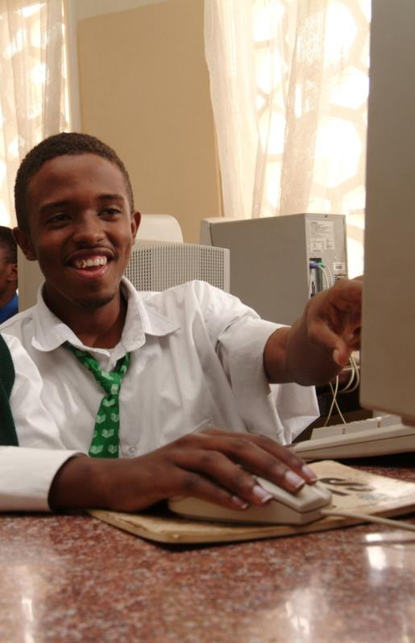
RATIONALE FOR SELECTING
ENTREPREURSHIP, ICT
AND RELATIONSHIP-BUILDING
According to Uganda National Examinations Board (UNEB) In 2020:
749,761 pupils sat for PLE
333,889 students UCE
98,392 Students sat for UACE

Slide 70
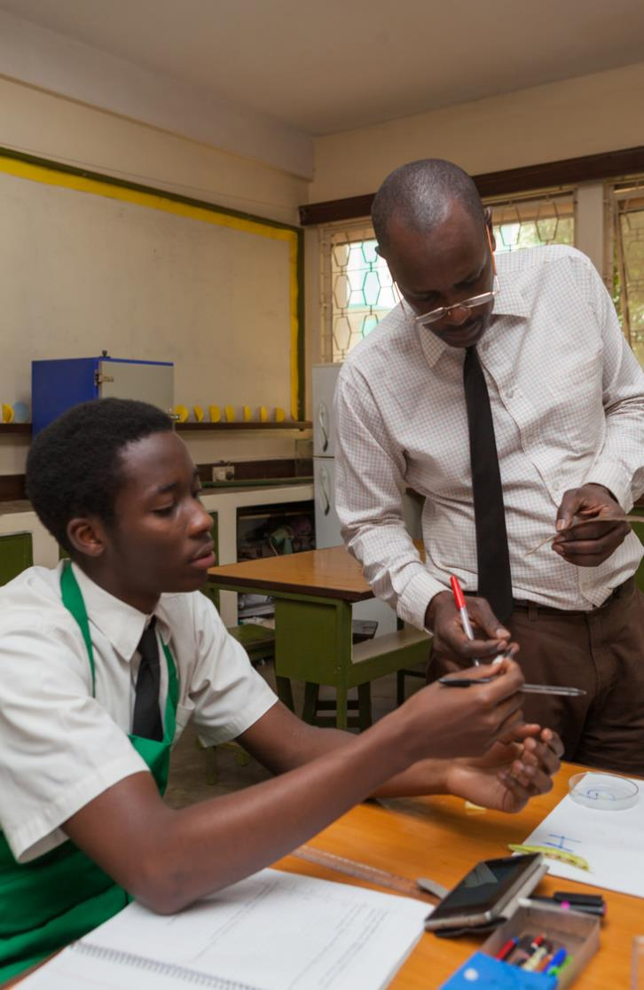
RATIONALE CONTINUED
Schools2030 supports schools that are disadvantaged
Most of our students are most likely to drop out of school
Need to equip our students with livelihood skills to compete in adult life

Slide 71
ENTREPRENEURSHIP
WHY: Ability to develop or build ideas to an existing idea with an aim of profit making:
In 2016, Uganda was ranked as the world's most entrepreneurial country, yet it remains a third world country (Global Entrepreneur Monitor)
Need to enhance entrepreneurship skills for sustainability
WHAT WILL BE MEASURED:
Negotiation
Originality of ideas
Customer service skills
Financial literacy

Slide 72
ICT
WHY: Technology is the science or knowledge put into practical use to solve problems or invent useful tools.
WHAT WILL BE MEASURED:
Ability to confidently use computer programs
Ability to search for information online
Ability to communicate online

Slide 73
RELATIONSHIP-BUILDING
WHY: Relationship-building skills are a combination of soft skills that one applies to connect with others and form positive relationships.
WHAT WILL BE MEASURED:
Networking
Ability to build lasting relationships
Seeking and offering help when needed

Slide 74
Thank you
Emily Tusiime
Regional Assessment Lead in East Africa
Aga Khan Foundation
Brenda Naggayi
Home School Teacher
Kampala - Uganda

Slide 75


WITH MANY THANKS TO OUR GLOBAL COALITION OF PARTNERS

